Slide 1
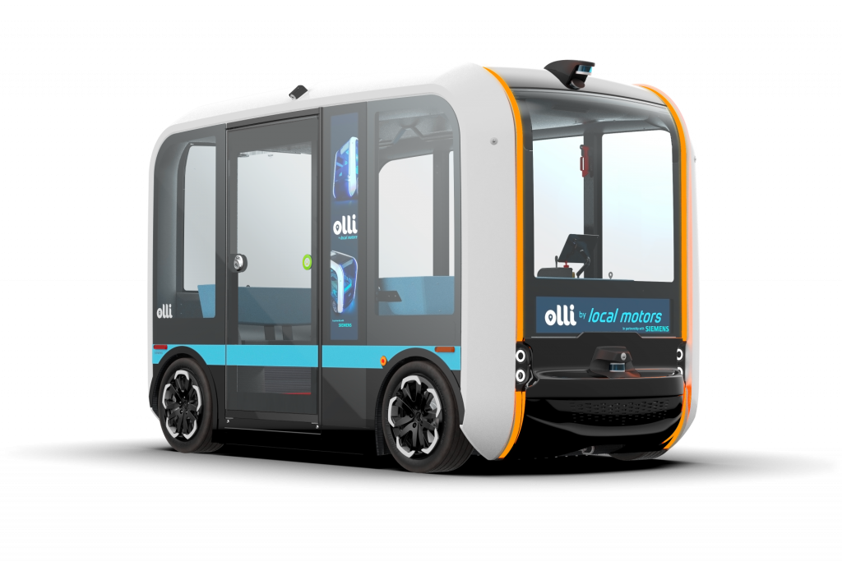
Passenger Emotion Recognition System for Autonomous Public Transports
H. Sebla KARABUNAR

Slide 2
TABLE OF CONTENTS
01
02
03
METHODOLOGY
FUTURE WORK
ABOUT THE PROJECT
What is autonomous public transport?
Why do we need emotion recognition system?
About demo
The methods used
Results
Strengths
Concerns

Slide 3
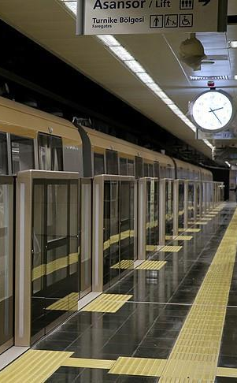
01
ABOUT THE PROJECT

Slide 4
Autonomous Public Transport
Autonomous public transport refers to the use of self-driving vehicles for public transportation purposes (Gärtner et al., 2019).
Autonomous public transport has the potential to increase efficiency and reduce costs, as well as improve safety by eliminating human error (Duarte et al., 2021).

Slide 5
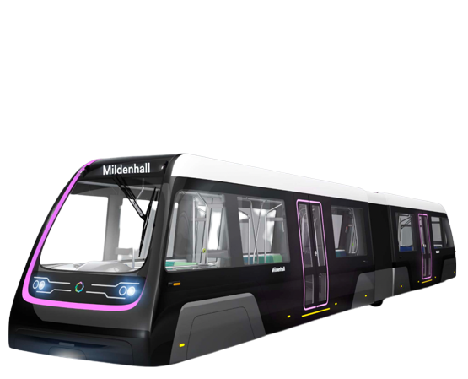
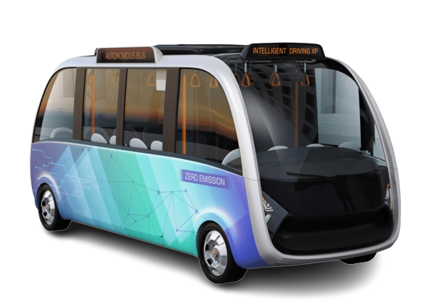
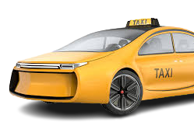
TYPES OF AUTONOMOUS TRANSPORTS
METRO
BUS / SHUTTLE
ROBOTAXI

Slide 6
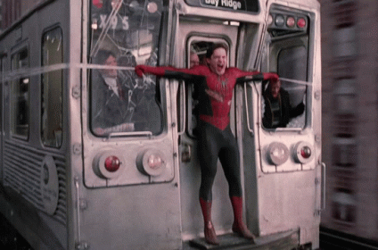
Emotion Recognition System
Improved safety
Enhanced customer experience
Improved efficiency and performance

Slide 7
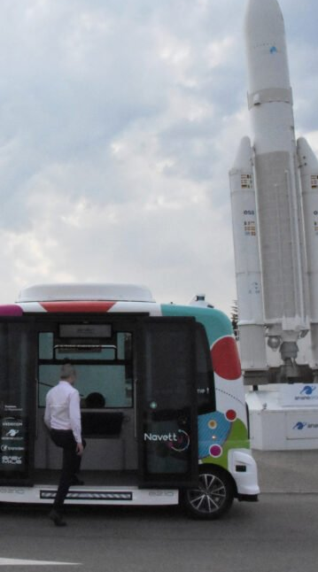
02
METHODOLOGY

Slide 8
DATASET: FER2013
01
02
03
AMOUNT
EMOTIONS
IMAGES
Angry Disgusted Fearful Happy Neutral Sad Surprised
Over 35,000 images of human faces
Training set: 28,709 Validation set: 3,589 Test set: 3,589
48x48 pixel greyscale images

Slide 9
SYSTEM DESIGN
TENSORFLOW
CNN MODEL
It is most-used library for emotion recognition.
(Abadi et al., 2016)
Preparing and pre-processing the data, defining the model architecture, training the model, testing (Goodfellow et al., 2016)
ADAM OPTIMIZER
KAGGLE
Gradient-based optimization algorithm to optimize the weights of a neural network.
(Kingma & Ba, 2014)
Training was held on Kaggle.

Slide 10
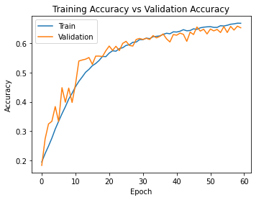
VALIDATION ACCURACY | 65.22%
TRAINING ACCURACY | 71.73%

Slide 11
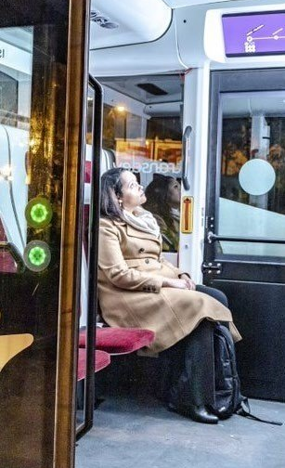
03
FUTURE WORK

Slide 12

STRENGTHS AND CONCERNS
HUGE STORAGE REQUIREMENTS
POSITION OF THE CAMERAS
PASSENGER PRIVACY

Slide 13
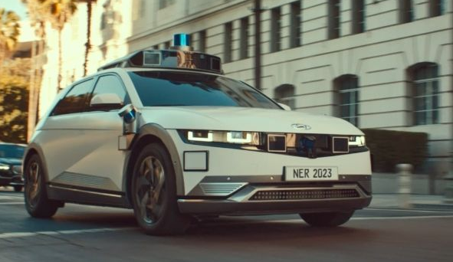
FUTURE WORK
Dataset can be extended.
A more accurate library can be used.
Training can be held on a stronger model.

Slide 14
REFERENCES
Abadi, M., Agarwal, A., Barham, P., Brevdo, E., Chen, Z., Citro, C., ... & Zheng, X. (2016). TensorFlow: Large-scale machine learning on heterogeneous systems. arXiv preprint arXiv:1603.04467.
Duarte, F., & Ratti, C. (2018). The impact of autonomous vehicles on cities: A review. Journal of Urban Technology, 25(4), 3-18.
Goodfellow, I., Bengio, Y., & Courville, A. (2016). Deep learning. MIT Press.
Gärtner, T., Happ, C., & Schade, W. (2019). Autonomous vehicles and their impact on public transport: A review of technological, economic, and social aspects. Transportation Research Part C: Emerging Technologies, 102, 43-59.
Kingma, D. P., & Ba, J. (2014). Adam: A method for stochastic optimization. arXiv preprint arXiv:1412.6980.

Slide 15
THANK YOU FOR YOUR ATTENTION!

